Slide 1

FIN
Friend in need

Slide 2
TEAM Members
S. M. Tasnimul Hasan (180204142)
Md Zahidul Haque(180204136)
Sanjida Aziz Tonny (180204122)
Fazlay Elahi Safin (180204119)
KH. Rifat amin (180204116)

Slide 3

FIN (Friend in need)
It’s an Android Application
It will contain emergency services (such as Medical Service, Ambulance Service, Fire Service, Blood bank etc.)
The app will fetch Our current location and redirect us to the nearest emergency service
Some services will be available to work without internet
We will create a Blood group database for AUST students

Slide 4




Development tools
Java
Android studio
Firebase Database
A team of five people

Slide 5
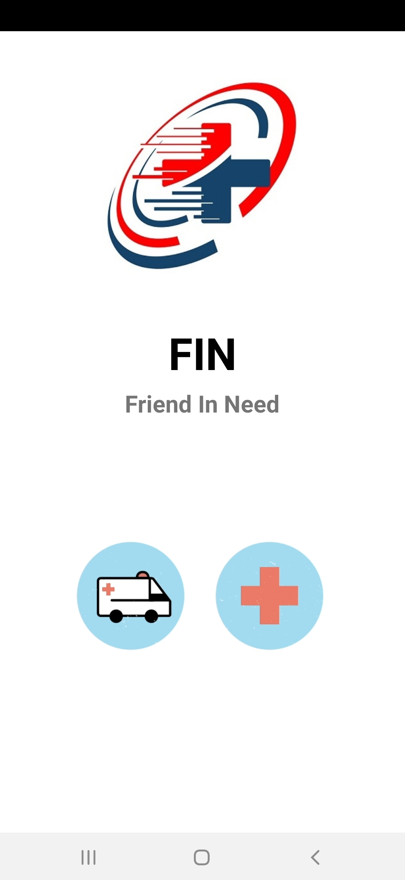
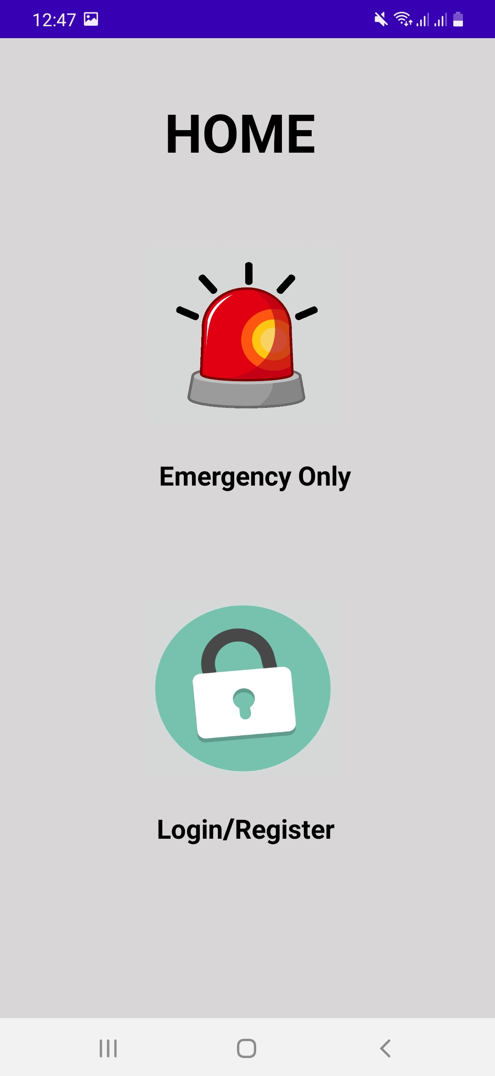
Pages

Slide 6
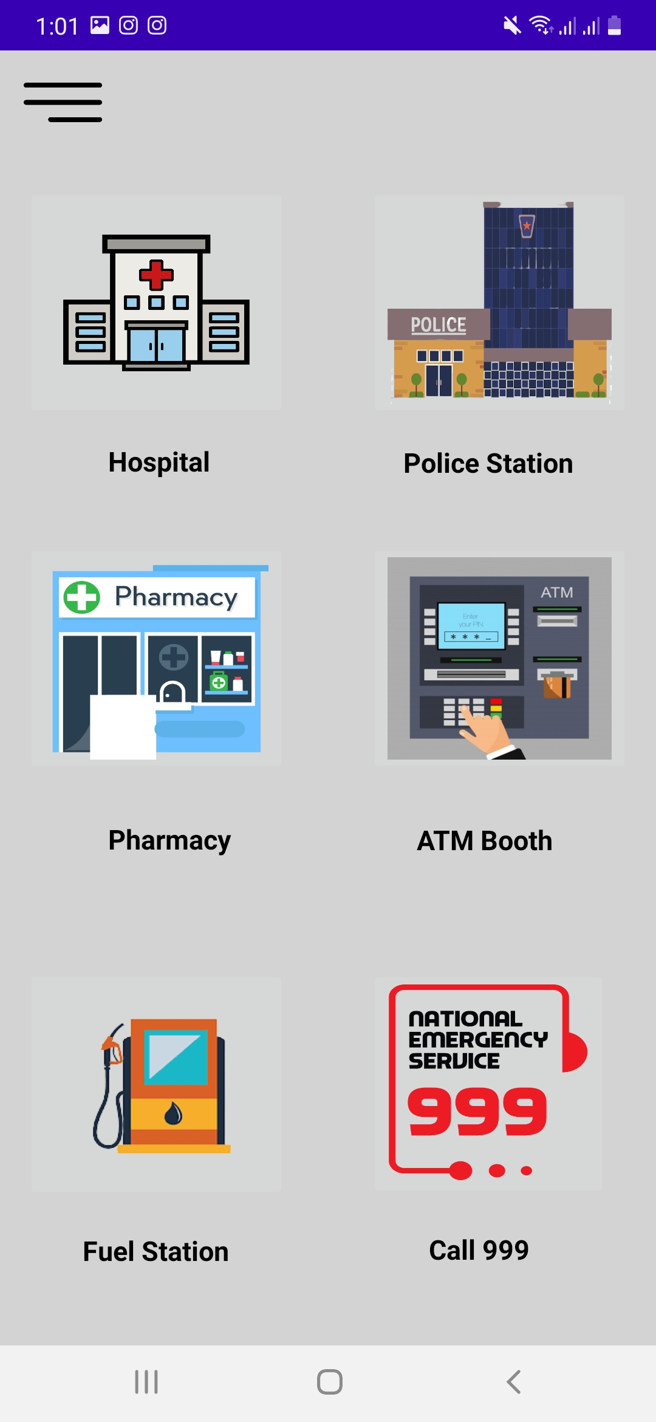
Emergency Only section
Hospital
Police Station
Pharmacy
ATM Booth
Fuel Station
Call 999

Slide 7
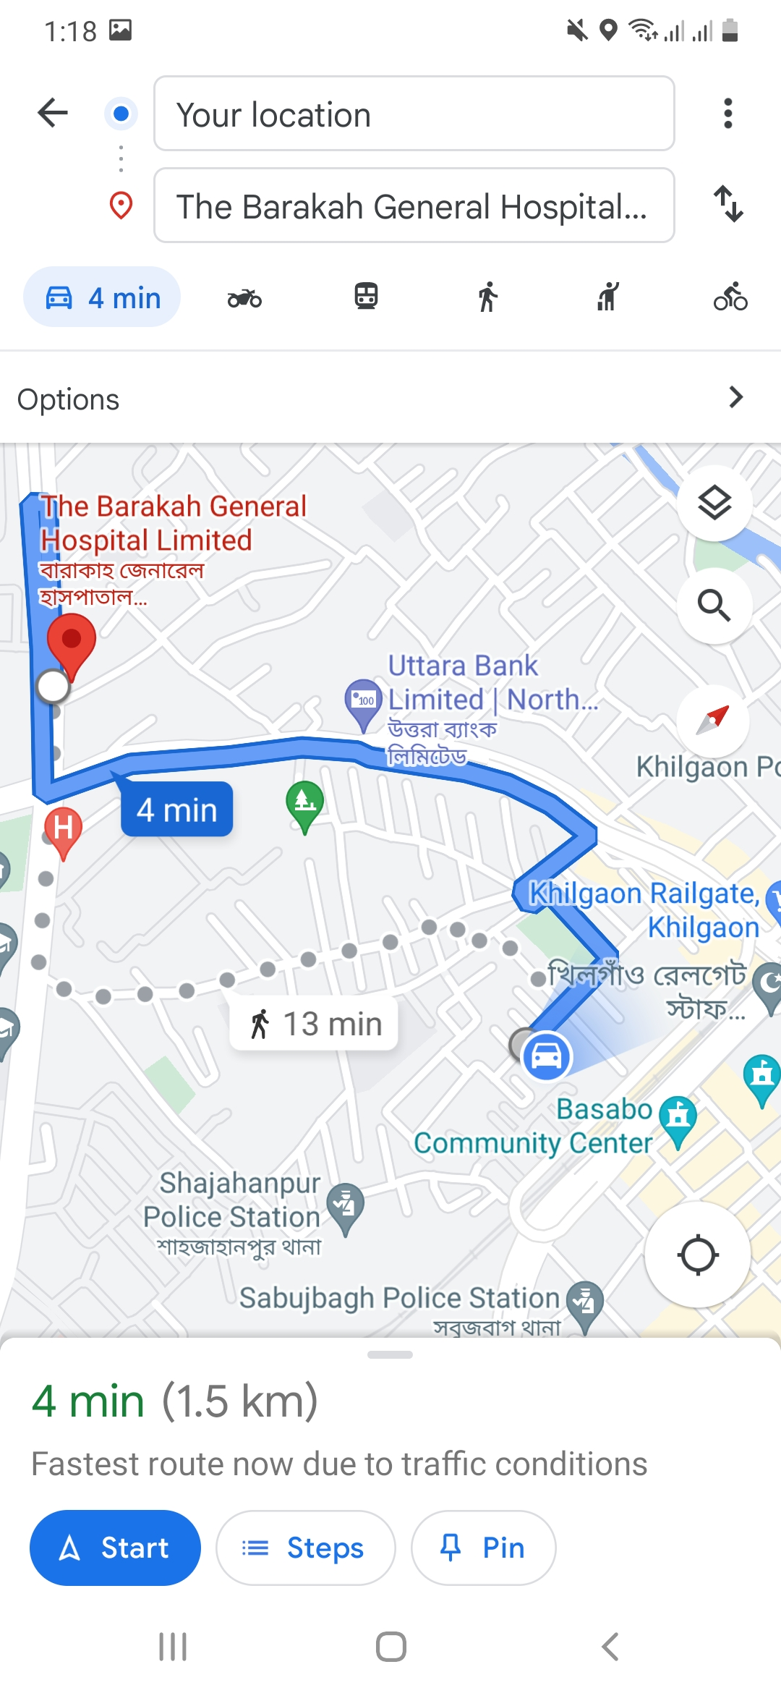
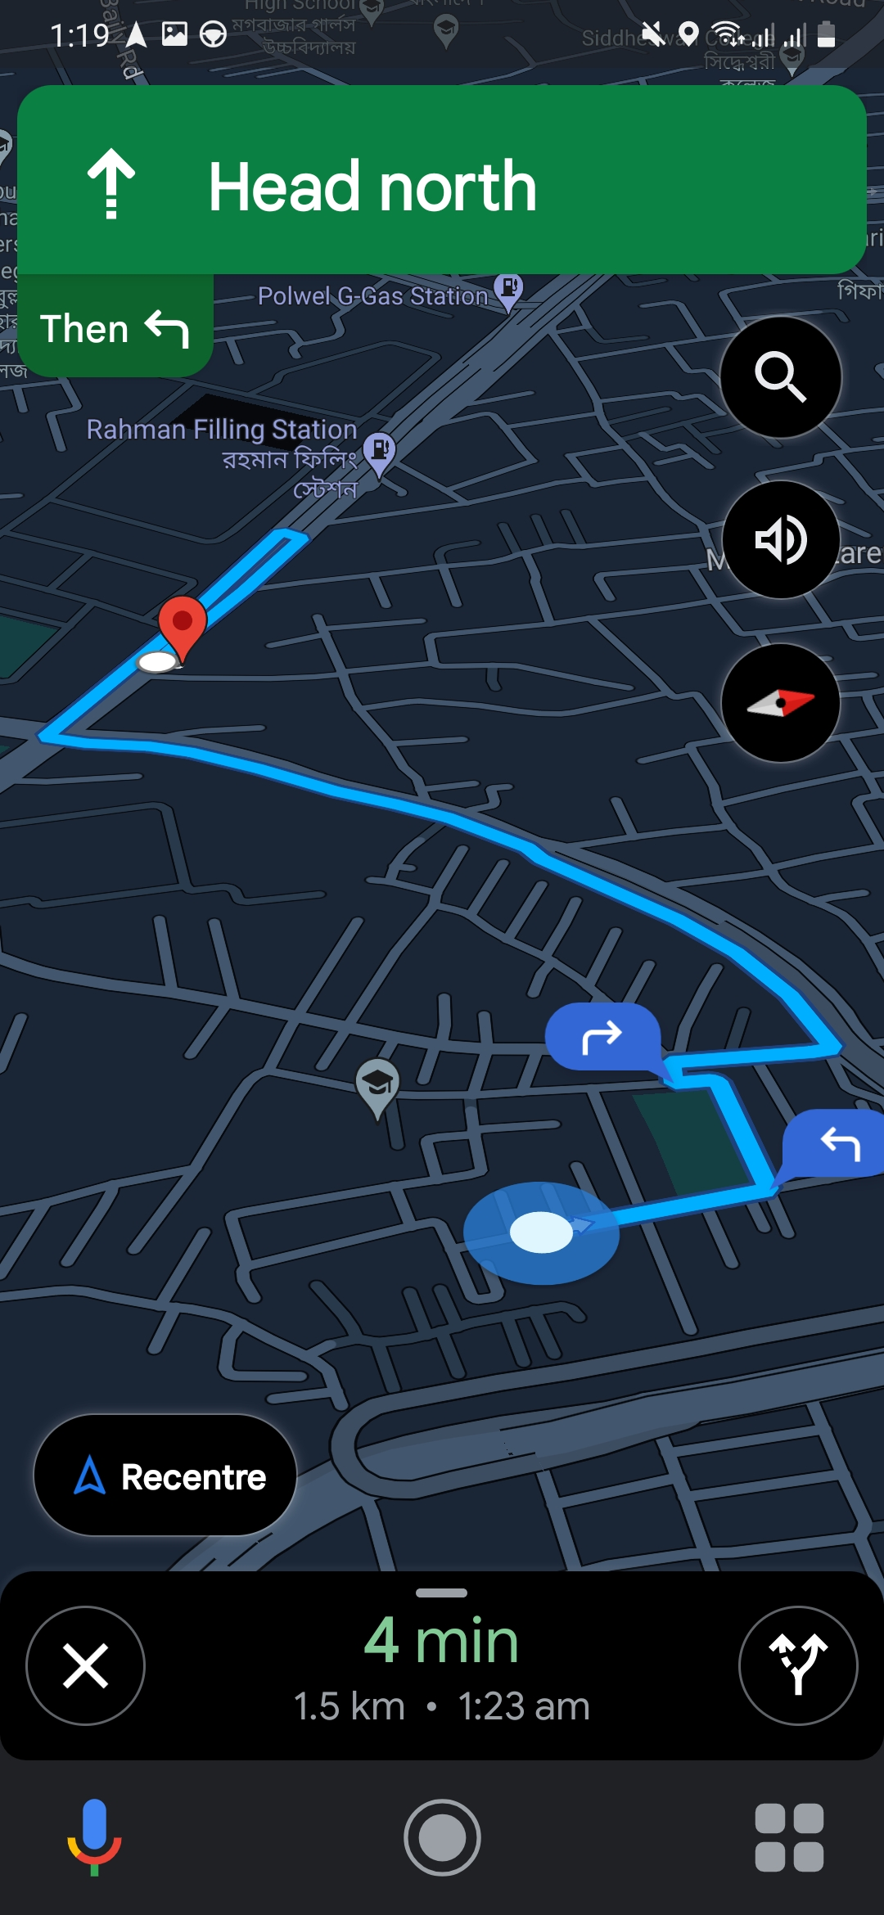
Emergency Only section

Slide 8
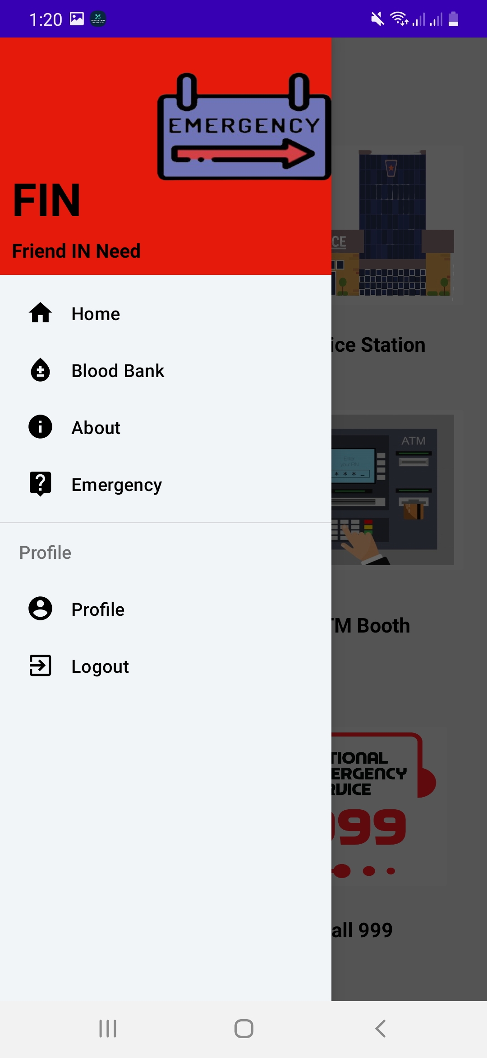
Navigation bar
Navigation bar helps the users to find any features of our apps quickly

Slide 9
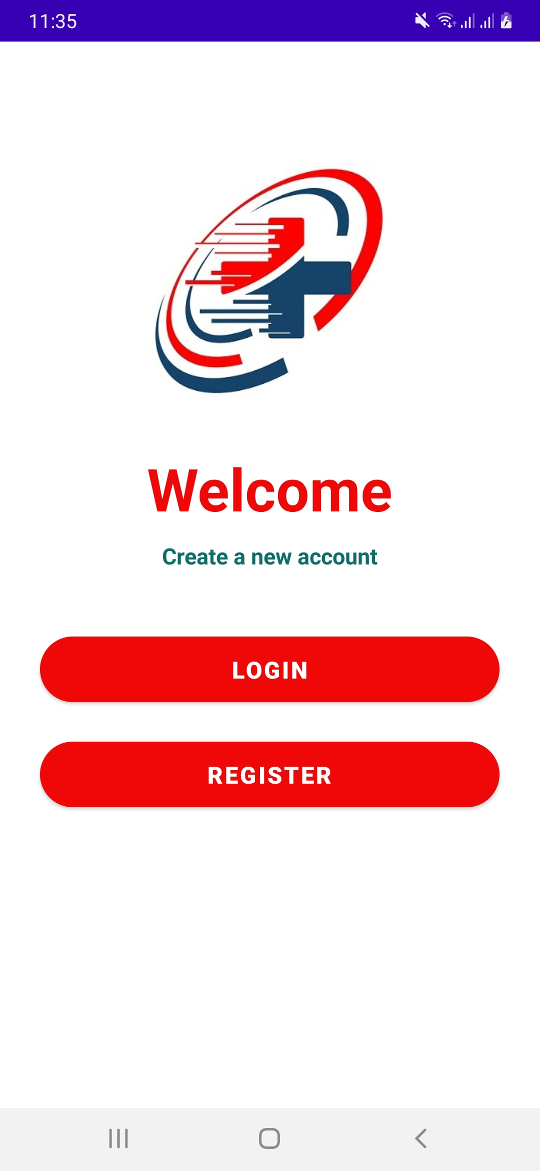
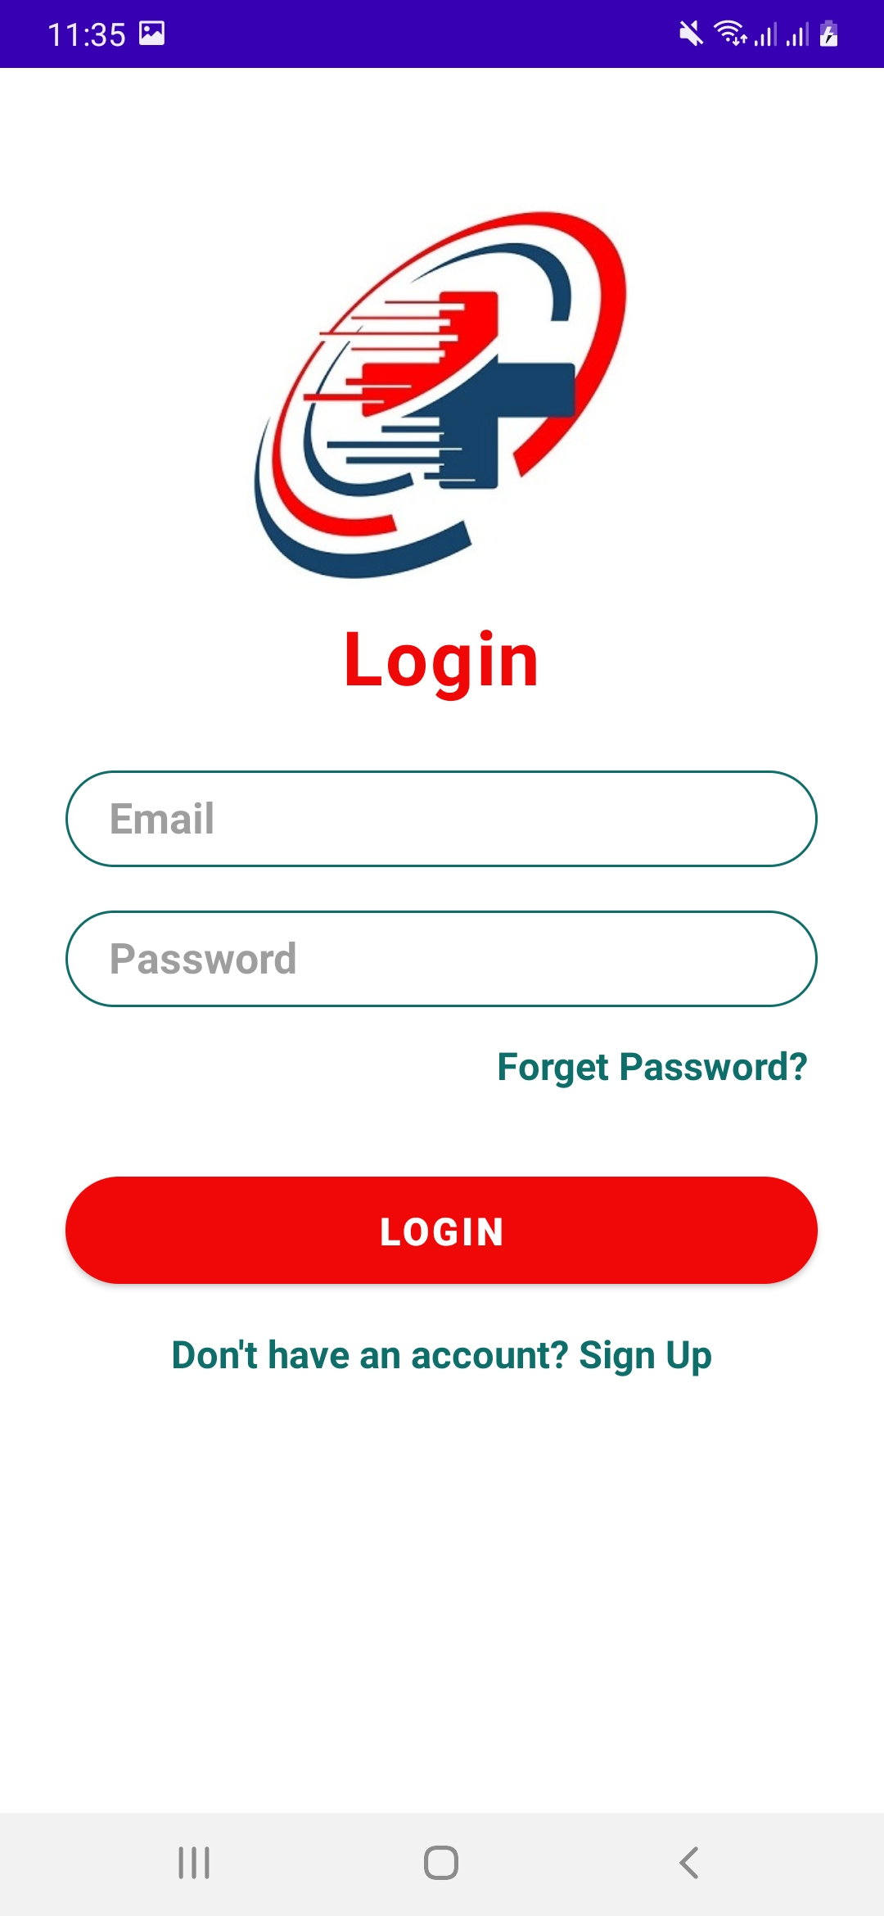
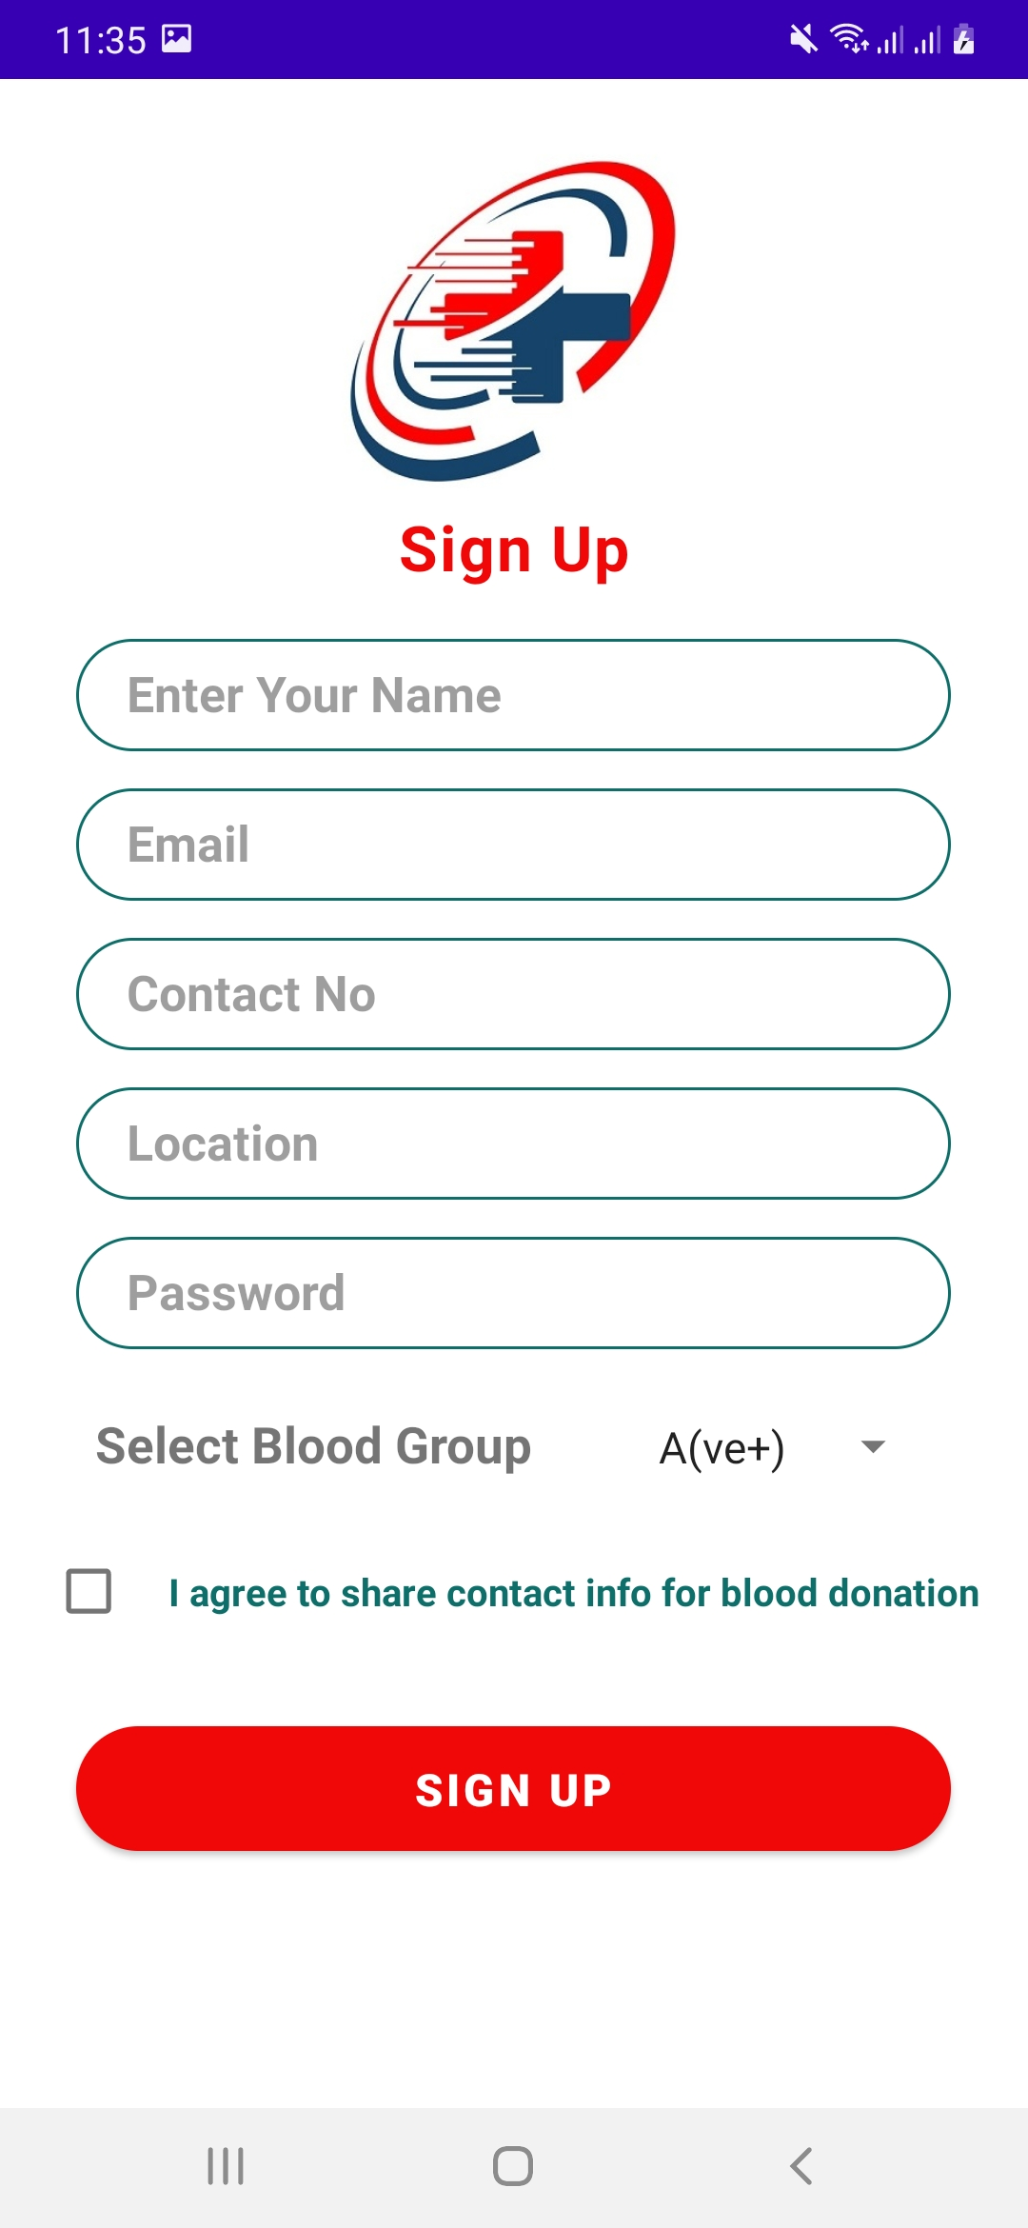

Login & Register

Slide 10
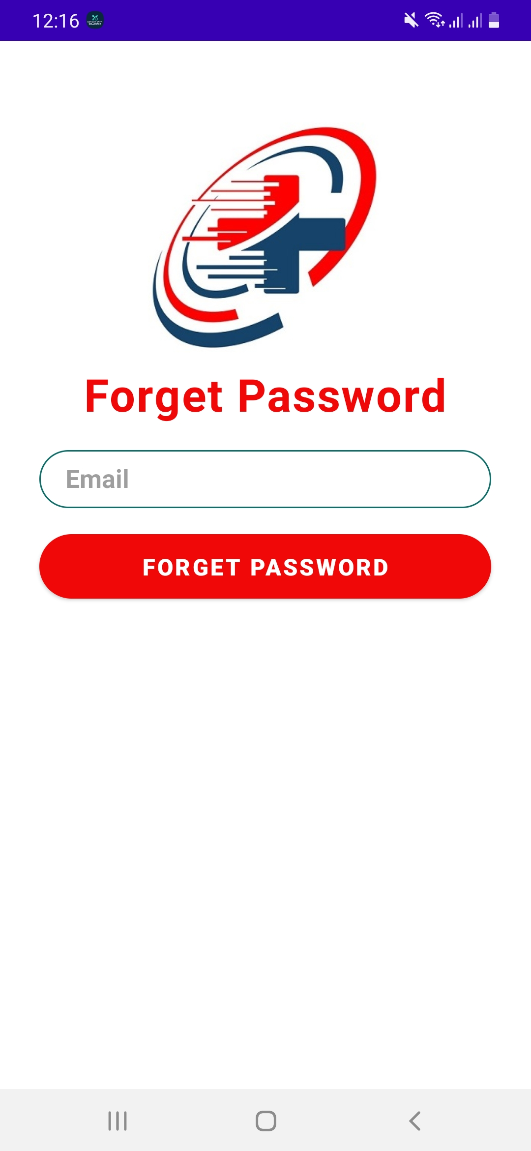
Password recovery
Do you forget your FIN account password?
Don’t worry !! You can recover your password by clicking “Forget Password” option in Login Section.
By providing your mail address you will get a link via email to reset your FIN Account password.

Slide 11
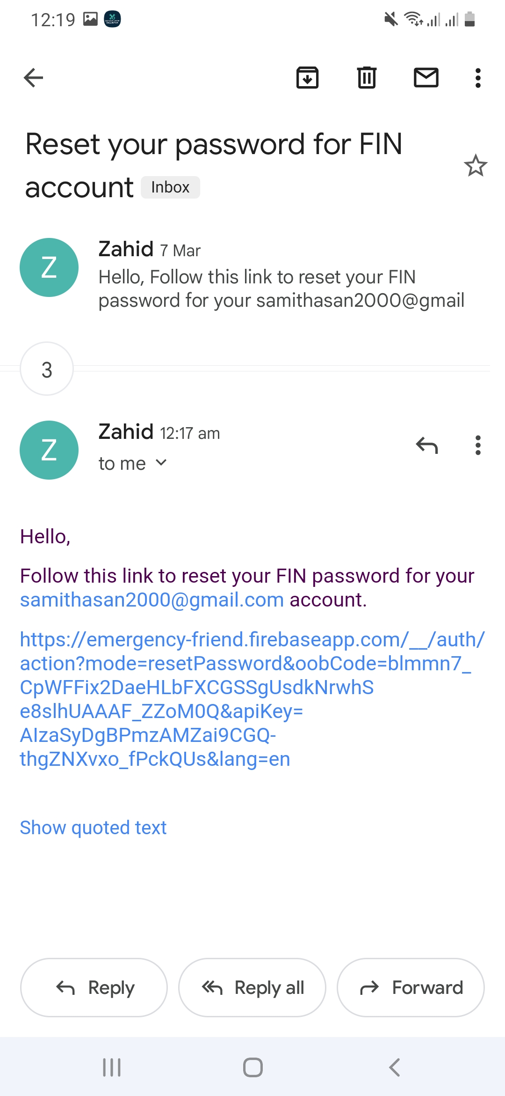
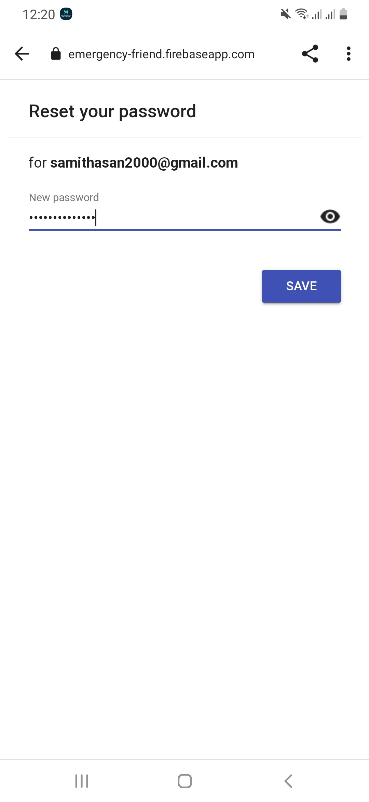

Password recovery
By clicking the provided link you can reset your FIN Account password

Slide 12
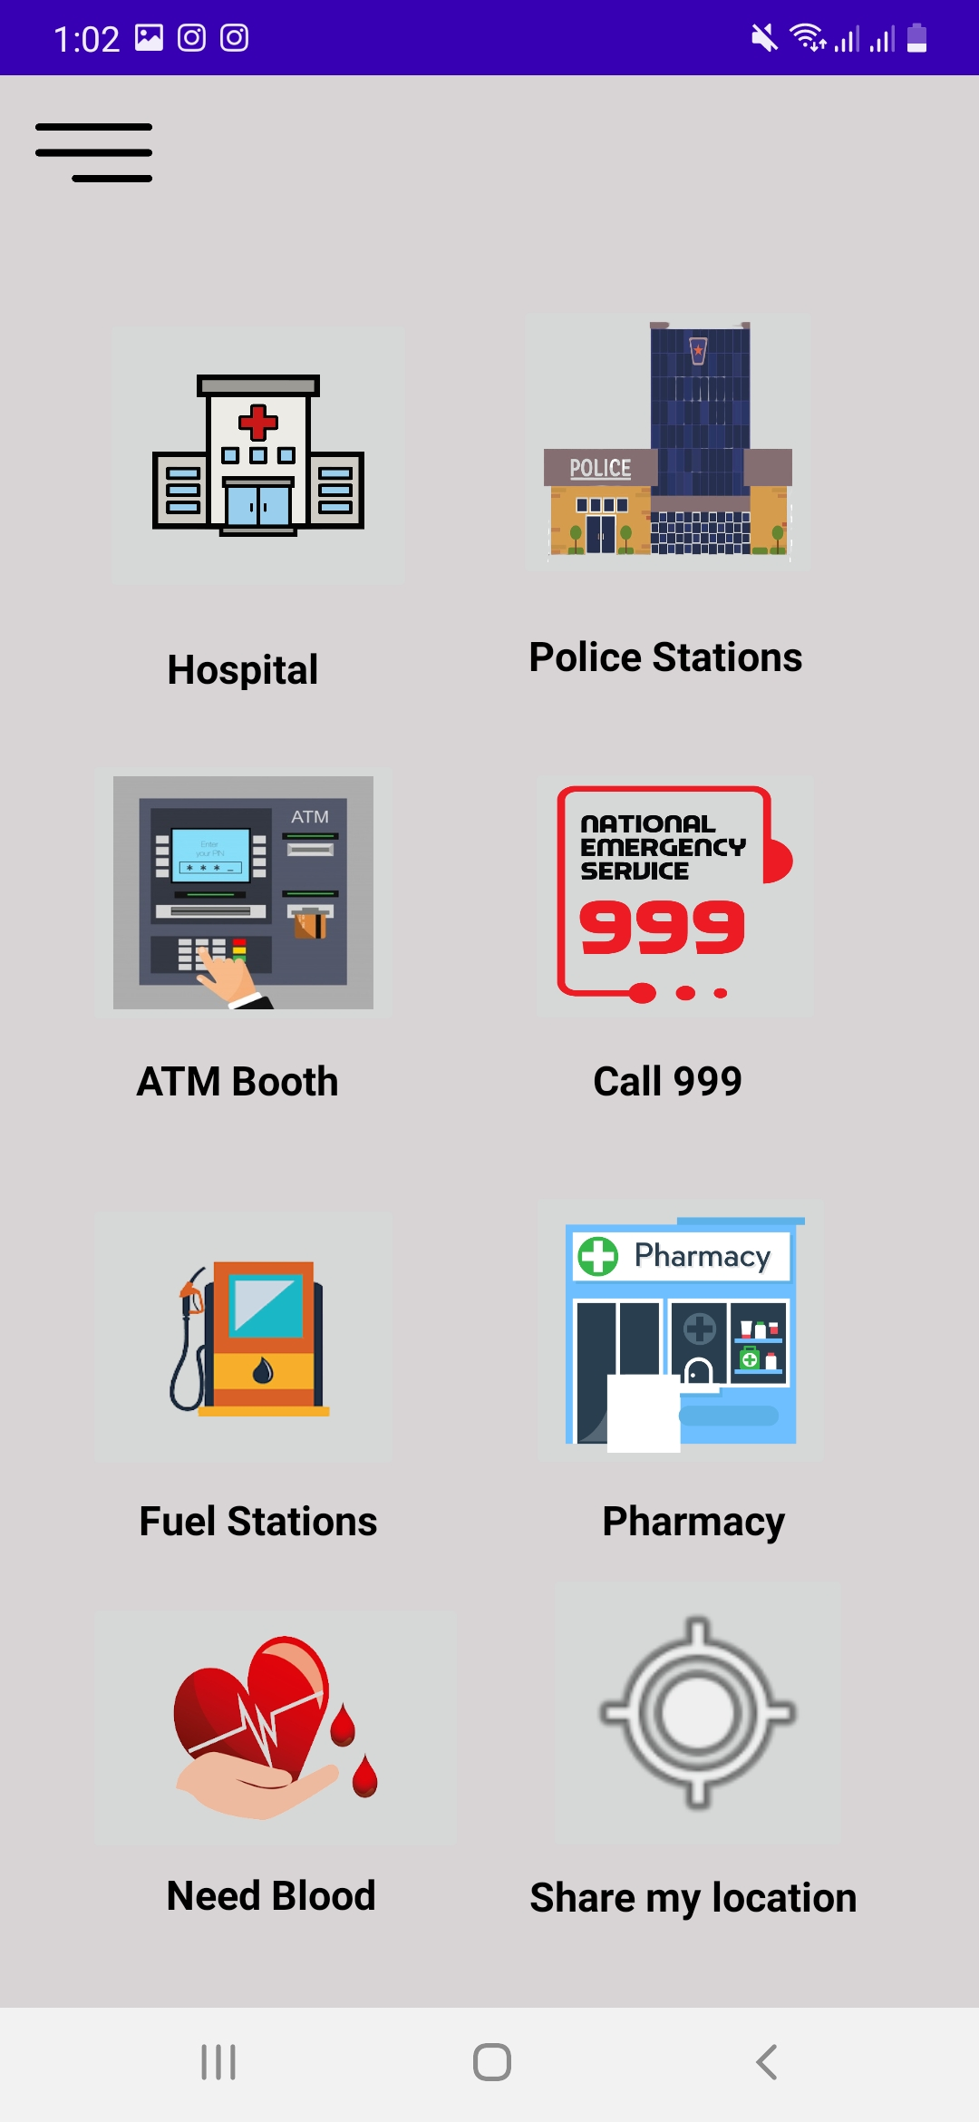
After Login
After login users can access Blood Bank
Users also can see nearby all the hospitals, police stations, pharmacies etc.

Slide 13
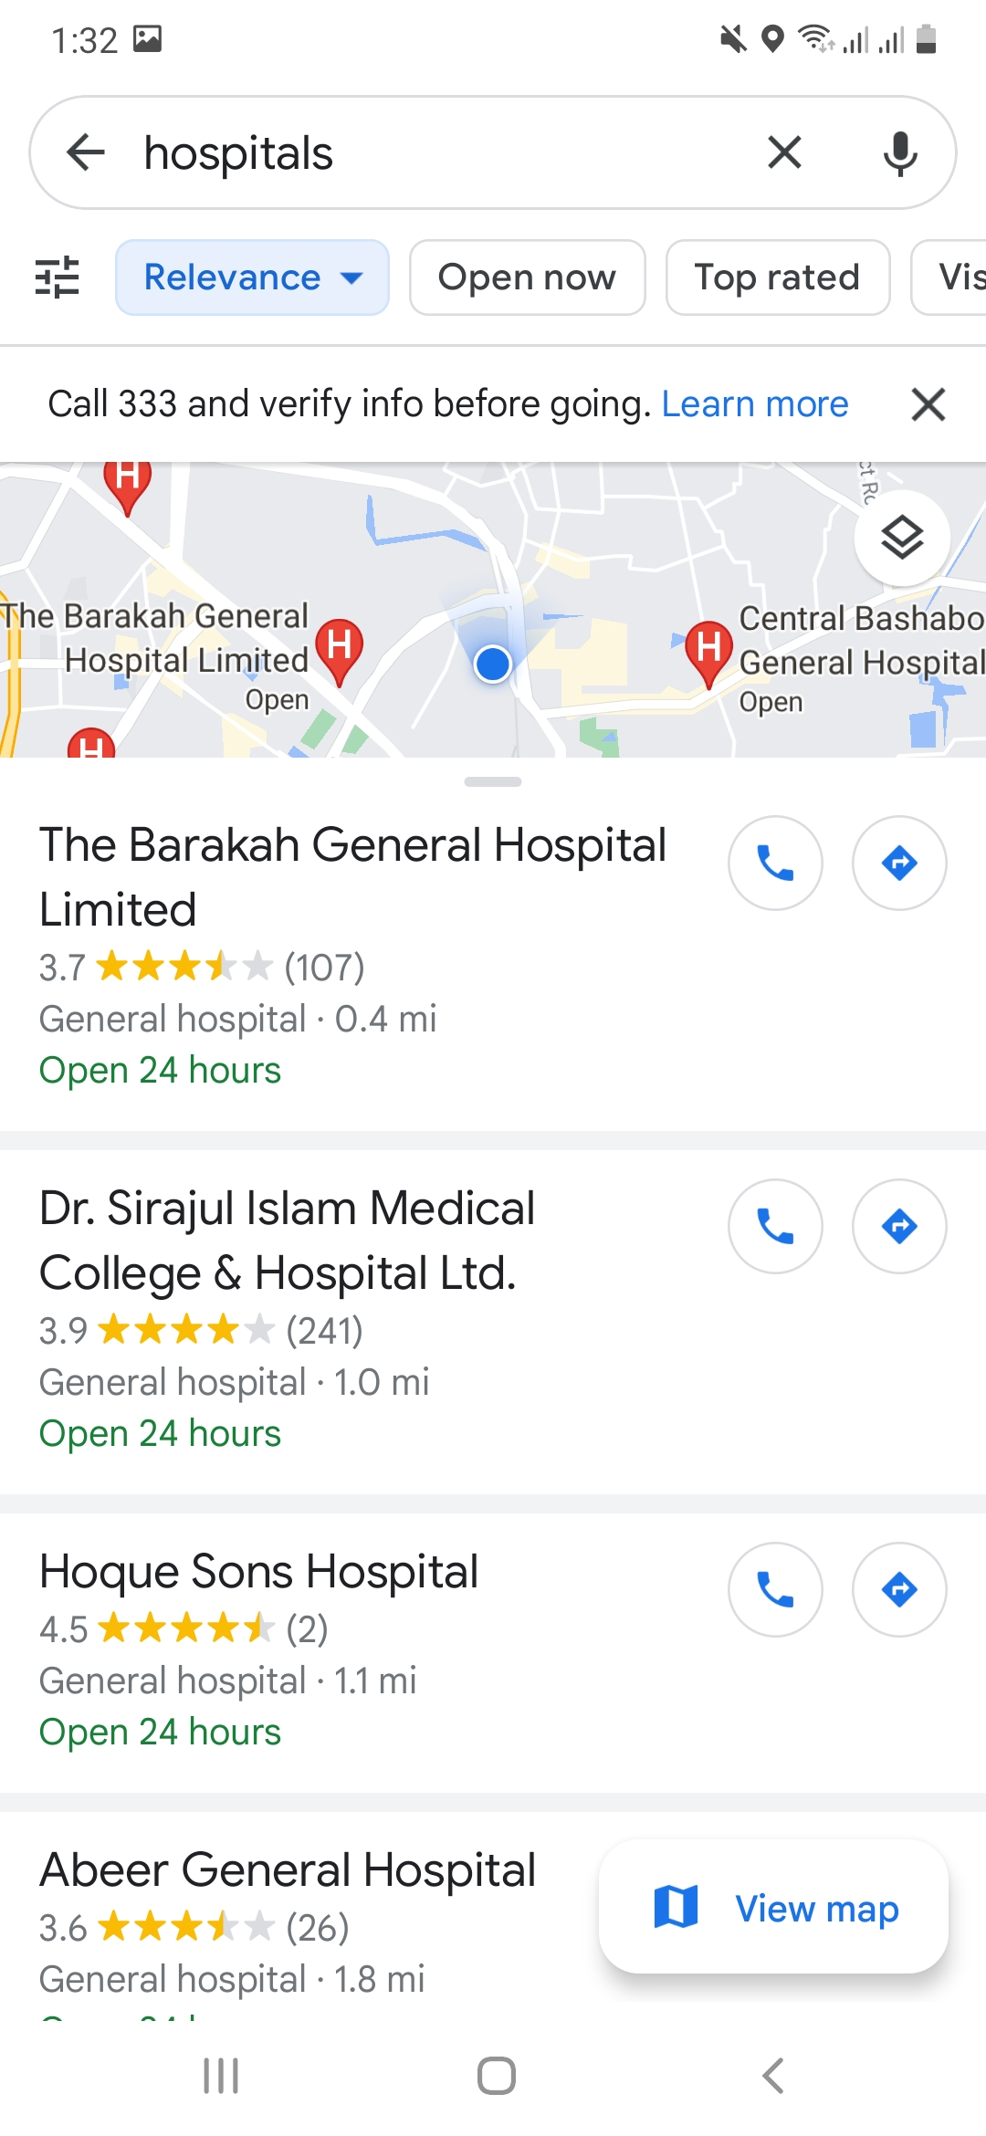
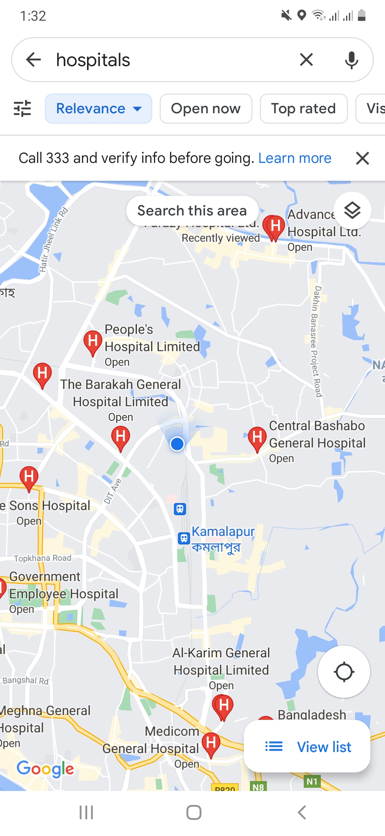
After Login

Slide 14
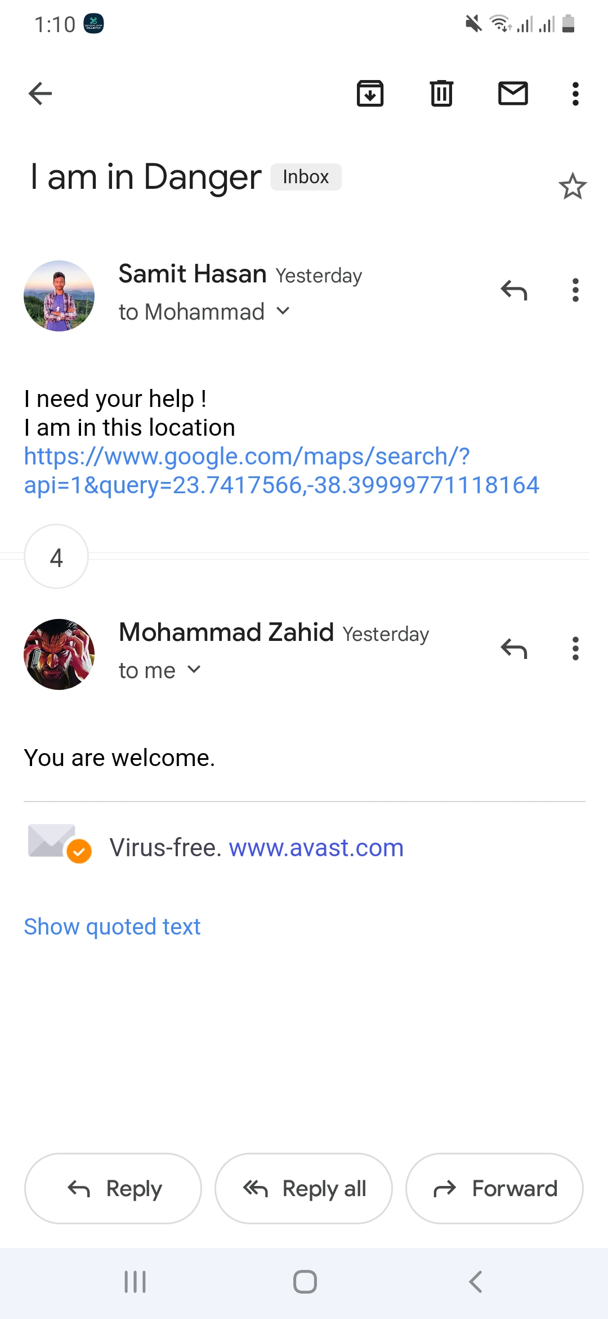
Share Location
By clicking “Share my Location” option you can send an email to your nearest or closest person in case of emergency

Slide 15
Conclusion
TO CONCLUDE, FIN WILL BE YOUR USEFUL FRIEND DURING EMERGENCY TIME . YOUR SAFETY WILL BE AT YOUR FINGERTIPS.
HOPEFULLY, OUR LIFE WILL BE MORE SAFE THAN EVER

Slide 17

Thank You

